Slide 1

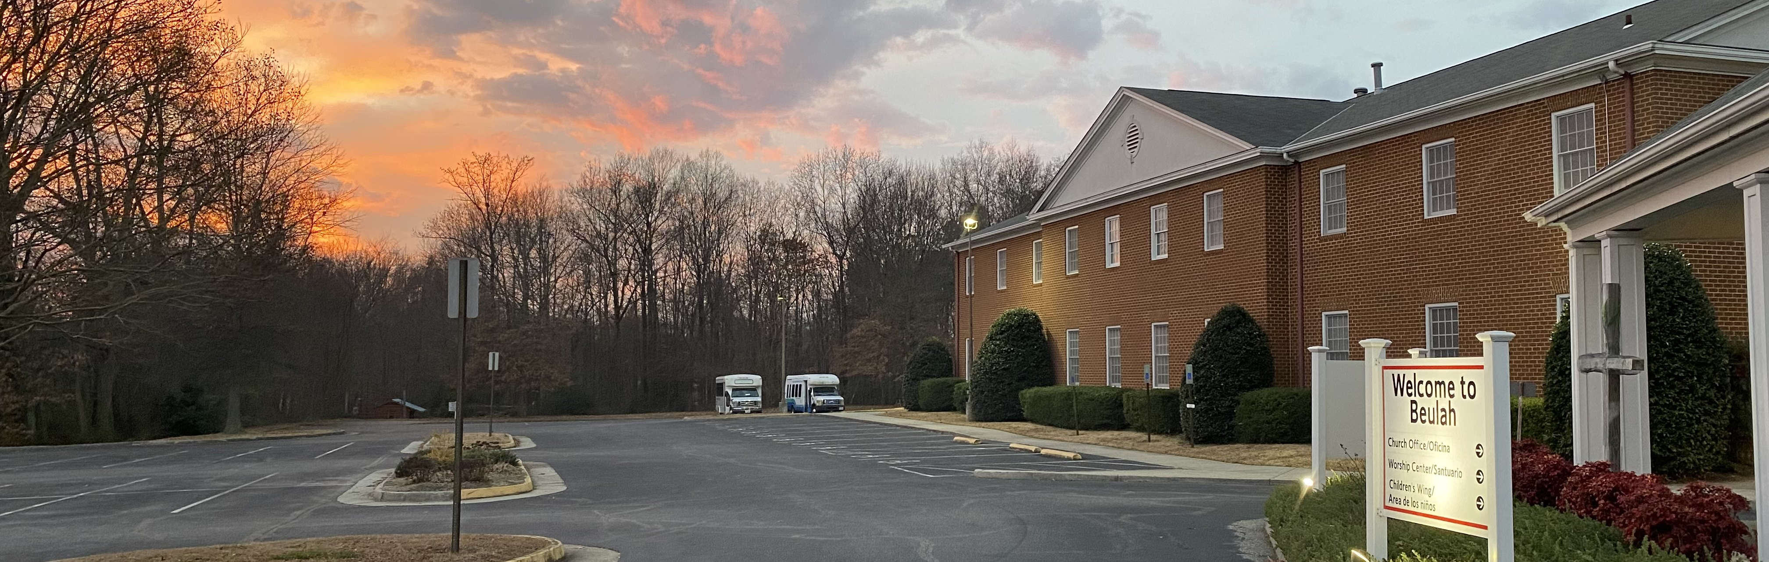

Transforming Lives As We Seek, Share, And Serve God.
FEBRUARY 2022
JESUS AND THE FIVE LOVE LANGUAGES
By Pastor Daniel Chun
THIS MONTH’S
THEME
Expressions of Love
When I think about the theme “Expressions of Love”, I immediately think about the Love Languages by Gary Chapman. It broadens my understanding of expressing love when love can be in the form of Words of Affirmation, Physical Touch, Quality Time, Gifts, and Acts of Service. It is amazing how God gifts us with different expressions of love.
Normally, whenever the topic of “Love Languages” is brought up, we would go in-depth about each one, and try to figure out what our love languages are. But what we don’t often do enough is actually see how Jesus himself, models all five love languages. When you take an in-depth look at His life, you’ll notice how Jesus expressed all five love languages perfectly. And ultimately, he shows us how to love one another. What I hope to do in this article is simply share evidence on how Jesus expressed these five love languages. And through seeing this evidence, I hope that it may inspire us to see how we can grow in our expressions of love to those around us.
Words of Affirmation – We see many times where Jesus would affirm people with his words. In particular one case reads in Mark 14, Jesus affirms with his words the woman who poured expensive oil on Jesus’ feet. He says, “She has done a beautiful thing”. This is special not just that the woman was affirmed for her action, but it also showed the people around them witnessing Jesus through his affirmation and challenging others to do the same.
THIS MONTH’S FEATURES
BE IN THE KNOW
  Heart Haven
  Contributions
  Next Gen Ministries
  UNITED METHODIST WOMEN
    Mission Witness
    Mending Hearts
    BIRTH ANNOUNCEMENTS
    THANKS
And be not conformed to this world: but be ye transformed by the renewing of your mind, that you may prove what is good, and acceptable, and perfect, the will of God. Romans 12:2
Continued on page 2

Slide 2



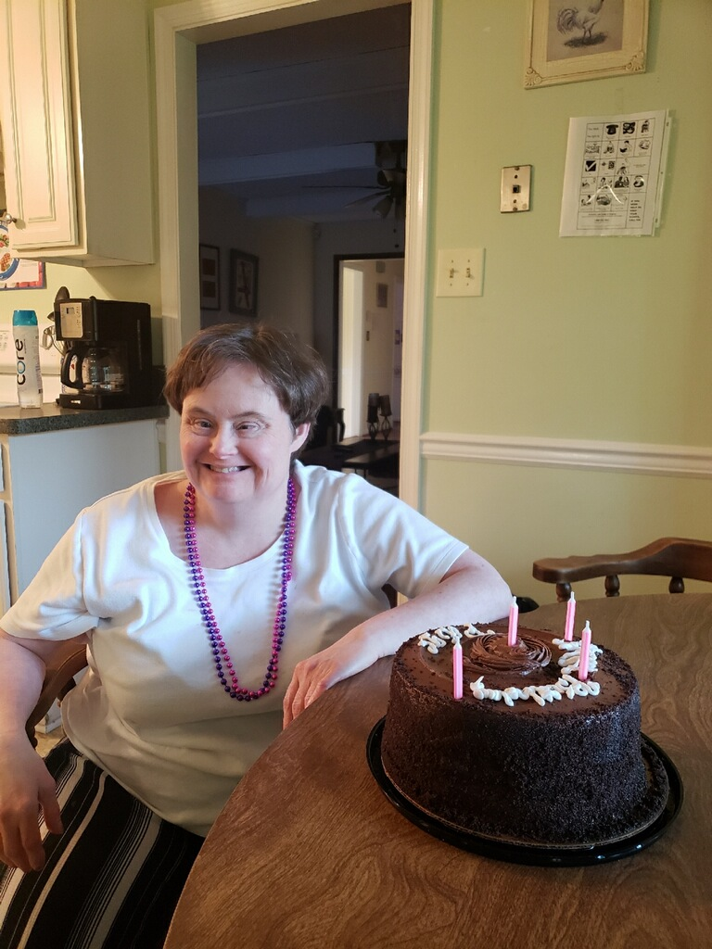


Continued from cover page
Quality Time – In addition to Jesus spending a lot of quality time (3 years) with his disciples, Jesus showed us another level of quality time as he spent time with the sinners and tax collectors. (Mark 2) This moment is special not necessarily because of the “amount of time” spent, but rather that Jesus was willing to eat and spend time with “sinners” in a society who rejected and didn’t want to spend time with them.
Physical Touch – Physical Touch (primarily, the laying of hands) was a big expression of love for Jesus. There was one particular moment when Jesus healed the man suffering from leprosy. Lepers, in history, were known to be outcasts who were not meant to be touched physically. By touching lepers, healthy people run the risk of contracting the disease. Jesus however, defies all societal norms, and touches the leper in need of healing. In doing so, the leper isn’t just healed, but receives an immense amount of love, and understanding. While no-one was willing to touch him, Jesus, in love, was willing.
Gifts – Jesus wasn’t a rich man, but he was indeed rich in Spirit. Even though they didn’t have money to feed the thousands, Jesus still expressed his love through gifts by miraculously praying for fish and bread. (Luke 9) In that moment, Jesus could’ve easily just gone home or continued on with his journey. But knowing that there were hungry people, Jesus showed his love by miraculously gifting the people with food.
Acts of Service – An iconic moment of Jesus’ acts of service is through the washing of his disciples’ feet. What makes Jesus washing the feet of his disciples special is that he, who was a teacher and Lord (John 13), was willing to lower himself to serve his disciples. Jesus doesn’t just serve but shows us that He was willing to go out of his way and even lower his own status, to serve those around Him.
As you can see, there is (and much more) evidence of Jesus being the perfect model of the five love languages. And I encourage us, knowing that we each have our own love language, to think about how we can grow in our expression of love. And there is truly one moment in the Bible where Jesus expresses all five love languages at once. It’s the moment that we should always remember, His death on the cross.
Take a moment to think about it (purposely not explaining it in-depth in this article). Can you see how Jesus expresses all five love languages while he is on the cross?* When you can see how Jesus expresses all five love languages, then I believe it will truly change the way we look at Jesus and his call for us to love those around us.
OPEN THE DOOR
AND DISCOVER THE ROOTS
OF OUR FAITH.
The Root Cellar is a blog, exploring the Hebrew history of our Christin faith. Come check it out at https://root-cellar.org/
BIBLE PASSAGES
TO REVIEW
JESUS’ DEATH
ON THE CROSS
Matthew 27:27-44
Mark 15:16-32
Luke 23:26-43
John 19:16-27
BE IN THE KNOW
FEBRUARY COMMUNION OFFERING
https://www.hearthavens.org/
Heart Havens provides residential support to adults with a developmental disability, but it's so much more than a roof and a bed. At Heart Havens, we empower people to discover what they love and pursue their hopes and passions. Whether that's getting involved in community theater, giving back to the community through a pet food drive, or simply having a Super Bowl party with friends, we support our residents as they find a way to make their goals and dreams happen. Your gifts help us provide the people we support with the best life possible-- and even small gifts make a big difference!
PAGE
2

Slide 3
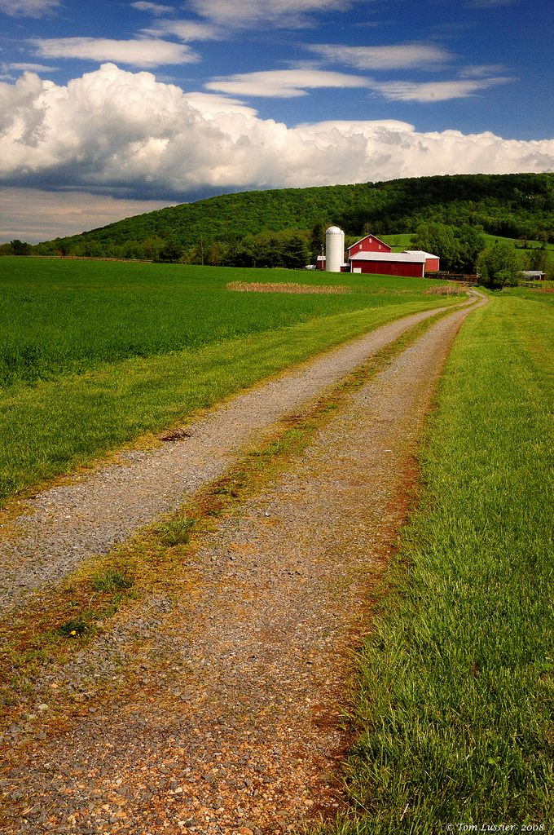
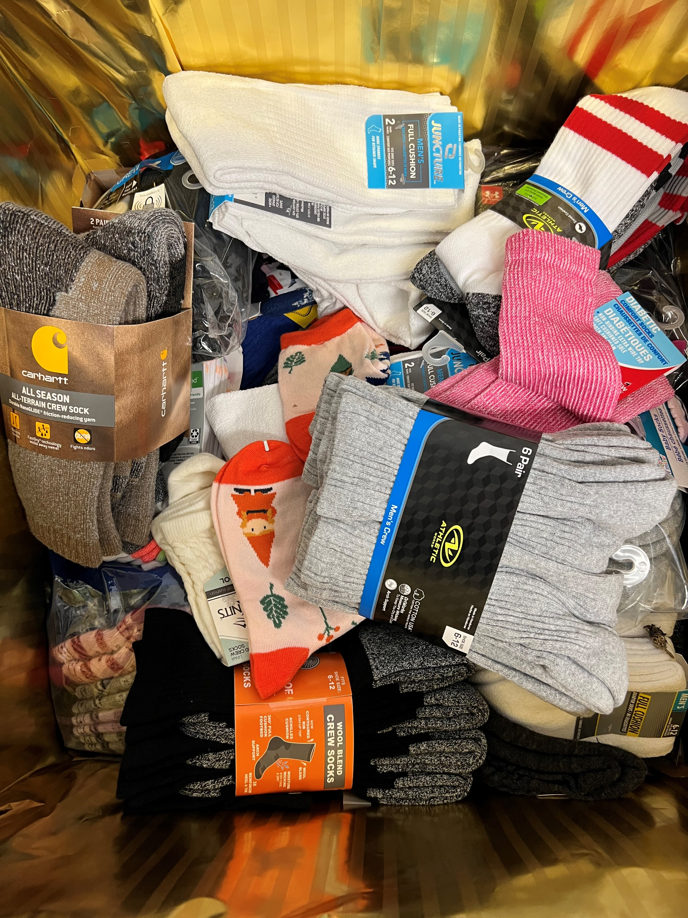
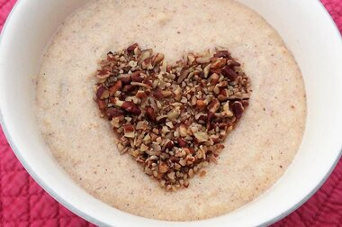
A LOVE STORY
By Suzanne Davis
I have had the privilege of experiencing various job positions. One position was as a manager at a gas station/fast food restaurant. The station was in the middle of nowhere and the next closest store was at least 20 minutes away. The restaurant next door was the hip place to be and where all the locals hung out. The very first customer I had at the station was a young man named Jason. He was working and living at his grandmother’s farm. He had no other family than her. He could have gone to college and “done something” with his life. He chose to stay with his grandmother and work the farm. Every night just after dusk he would come by the store and get a drink. I would ask him how he was or how his day went. He would tell me about a calf born or a tractor that had broken down. After a year of this conversing, he came in one night with a big sigh. He and his grandmother had been arguing. He felt that she did not appreciate him though he worked the farm and gave up college so she would not have to be alone.
His grandmother came in almost every Tuesday and Thursday for a chicken sandwich and a cup of coffee. Her topic of conversation was almost always about how her grandson Jason was wasting his life working on the farm. In fact she even at one point thought of selling the farm so he would “move on with his life”. They loved each other and wanted what they thought was best for each other. Their difference of opinions caused much strife between them.
About a year and a half after first meeting them both, Jason was found in the field at their farm. He had an aneurism while working. About a week after Jason had died I found his grandmother crying in the parking lot of the station because she couldn’t clean her windshield. She asked me to help her clean it. As I cleaned her windshield, she told me about how much she misunderstood her grandson and there where so many “little things” she was noticing he would have done for her without her paying attention to them. About a month later she too passed away from a heart attack. Many of the locals said she died of a broken heart.
Both Jason and his grandmother loved each other deeply and would have given up everything for one another. Jason expressed his love by working hard and selflessly to make sure his grandmother was safe and secure. His grandmother expressed her love by being willing to give up everything she owned to secure his future. Neither of them where able to see those expressions of love in their full beauty. Their story will forever be embedded into my heart.
All throughout the Bible we read of the “little things” God has done to express His love for us, up to giving up it all to secure our future with Him. What ways does God let you know He is there and loves you? What ways do you let God know that you love Him?
interested in being
interested in being
SHERBOURNE FOOD PANTRY
MONTHLY REQUEST
During the month of February, the Sherbourne Food Pantry is asking for donations of hot/cold cereals and canned/powdered milk. This can include Instant oatmeal, grits, and types of non-refrigerated milks found in the juice isle of your local grocery store.
CONTRIBUTIONS
Thank you again for your generosity throughout the year 2021. Your support provided 5354 lbs of food for families in our community through the Sherbourne Food pantry and 75 Christmas dinners. Beulah also has provided 403 pairs of socks for individuals in need through CARITAS - Thank you, God bless and continue to GIVE!
For your convenience there is a white donation cabinet located outside, under the Breeze Way, for after hour drop offs.
PAGE
3

Slide 4



BEULAH
UMW MISSION WITNESS
The Prayer Calendar is published annually by United Methodist Women. It invites us to pray as one people responsive to God’s
call to relationships of caring, connecting and healing in a world
of uncertainty in all but the love of God. Each month we share a testimony from a person in mission for Christ through the United Methodist Church.
Scripture for the Month
When your words turned up, I feasted on them; and they became my joy, the delight of my heart, because I belong to you, Lord God of heavenly forces. Jeremiah 15:16
WITNESS
May those who are looking for joy in wrong places find it today by encountering God’s divine presence in the loving fellowship with others.
Hikari K. Chang, UMW Regional Missionary
serving at the Wesley Foundation, Tokyo, Japan
.
PRAYER
Please pray for international missionaries serving in Burundi, Cambodia, Cameroon, Canada, and Chile and our United States missionaries serving in California, Colorado, Connecticut and Delaware.
UNITED METHODIST WOMEN “MENDING HEARTS”
The Richmond District annual Charter for Racial Justice event will take place virtually
on Saturday, February 26. We will gather via Zoom to visit some of the “Mending Walls” murals scattered throughout Richmond that address racial justice issues. After hearing from the artist who coordinated the creation of the murals, attendees will be placed in break-out groups to discuss specific murals and their impact on viewers. Look for registration information with details in upcoming bulletins, and plan to join in the discussion.
interested in being
For those who may not be familiar with NextGen Ministries. NextGen Ministries at Beulah is a new ministry aimed to bridge the existing ministries of Children, Youth, and College together under one umbrella. As our name implies, NextGen is a ministry focused on the next-generation of Christ-followers. Our vision is to build and raise the next generation of Christ-followers that will become the sharers of the gospel.
Although our ministries are new, restarting, and/or rebuilding, we are centering on a common ministry style. Using small groups as our primary ministry style, each ministry focuses on meeting together as a small group to have worship, fellowship, discipleship, and missions.
Right now, we are proud to say that we are in a developing and growing stage. Our youth ministries have been meeting again, focused on having worship together once a month (2nd Sunday of the month) and an outing once a month (4th Sunday of the month). Our college ministry meets every 1st and 3rd Thursday at my house with worship and fellowship at the center. This small college group is called Family Group, which focuses on the family we are in Christ. And lastly, Children’s Ministry has Children’s Church, hoping that worship for Children will once again be the norm.
In these praises, we ask for prayer requests. The major effect Covid-19 had in all our ministries is an increased disconnection between people and God. More and more people are no longer attending church, and more and more people no longer feel the need for Jesus in their lives. We ask that you pray for reconnection, for our youth who no longer come out, for college students to see the need for Christ, and even our children and parents who constantly struggle with faith in these times.
PAGE
4

Slide 5

UMW SOUP LUNCH
Mark your calendars for our soup lunch on Sunday, February 27, after 11:00 worship. There will be a variety of soups, breads, and desserts to enjoy, and the proceeds will go to missions. Sign up at the Information Center for your choice of soup, and plan to join us for some warm fellowship.
BEULAH’S BEST
Beulah’s best will meet February 21 at 10:00am in the Fellowship Hall. Come and join us. Everyone is welcome. If weather is bad, even if the schools are not closed we may still cancel. You can check with the church office or call Nora Foster at 804-639-5448.
ROSEMALING FLOWERS
On Thursday, February 24, at 5:00 pm the Creator’s Studio will offer a DIY class. We will be painting Valentine flowers on wood through the art of Rosemaling. Rosemaling is a style of decorative painting stylized flower, scrollwork, lining and geometric elements, often in flowing patterns. All materials will be provided for this beginner's level class. If you are interested, please sign up at the Information Center as space is limited.
ARE YOU UP TO DATE?
Are you receiving the weekly email on Thursdays? Do you receive the monthly Beacon through email or by a traditional mailing? Do you receive your quarterly statements or your church envelopes? If you answered no to any of these questions, we need to update your information. You can update your information by filling out a connection card (located in the pew and place it in the offering basket after filling it out), or calling us at 804-275-2325 or emailing the church at office@beulahumc.org,.
PRAYER SHAWL MINISTRY
On these cold wintry days when it is difficult to go anywhere, maybe the pandemic or snow prohibits travel? Have you though about knitting or crocheting? Don’t know how? Would you like to learn?
A dedicated group of ladies meet monthly at the church to create Prayer Shawls. The Shawls are made to convey to the receiver the love and compassion of God. These tangible items when put around one's shoulders remind them of the love and prayers for healing or comfort that is being sent for them.
The group meets every third Tuesday afternoon from 1:30 pm to 3:00 pm in room 111 of the church. You are welcomed to attend.
If you would like to give a prayer shawl to someone, they can be found in the cabinet at the Information Center. Please be sure to write down who you are giving the shawl to so we can keep record.
FEBRUARY CALENDAR
02 11:00 am Lynda Spencer Celebration of Life
03 5:30 pm Family Group
04 6:00 pm Mariners Dinner
06 9:00 am Beulah Food Distribution
08 10:00 am Mary Farmer Circle of Love
7:00 pm Finance
12 2:00 pm First Touch Sports Registration
13 7:00 pm Youth Super Bowl Party
15 12:00 pm Senior Lunch
1:30 pm Prayer Shawl Ministry
2:00 pm Hugging Hearts
16 1:00 pm Wesleyan - Stratton
5:00 pm Cares Team Meeting
17 5:30 pm Family Group
19 11:00 am BB Taylor Celebration of Life
21 10:00 am Beulah’s Best
22 5:30 pm Prayer Team Meeting
24 10:00 am UMW Missioins Meeting
5:00 pm Creator’s Studio Craft Night
27 12:00 pm Soup Luncheon
OCCURRING WEEKLY
Sunday Worship
Sunday School
Monday Bells Rehearsal
Card Ministry
Men’s Bible Study
Scouts
Tuesday Cub Scouts
Thursday Choir Rehearsal
Creator’s Studio
Girl Scouts
Quartet Rehearsal
Friday Dog Ministry
WE ARE HIRING
Join Our Team
Beulah has an opening for a Part Time Bookkeeper to work with our current finance team. To learn more about this position please visit the church website
at beulahumc.org/employment.
PAGE
5

Slide 6
THANK YOU
To: Beulah Friends
From: Barbara Dudley, Worship Chair
Now that the advent/Christmas season is over, I wanted to thank so many who helped me during that time. These are my Christmas “Angels” who are always so willing to help me when I ask them. They are : David Dudley, Carolyn Salmon, Anne Christopher, Pat Soyars, Sandra Sanderson, Barbara Tinsley, and Nancy Morris. What a blessing they are!
To: Beulah
From: Sarah Eastwood
Thank you Beulah for your prayers, phone calls, cards, and caring following the death of my son-in-law and my auto accident. A special thank you to Pastors Don and Daniel for "coming to my rescue" following the accident and staying until my family arrived.
To: Beulah Church
From: A man who was in need
I just want to say thank you for all you have done. You helped me with a hotel when it was cold out and helped me financially. Things are hard right now, but you truly have given me hope to keep my head up and keep pushing forward!
To: Everyone at Beulah
From: The Everett and Maher families and Brenda McMatt
Thank you so much for the calls, prayers, and thinking of us during Don’s illness and his passing. It meant so much to us all.
To: Joanne Barreca and Beulah United Methodist Church
From: Patrice Wilson, Principal at Bensley Elementary School
Thank you for your generous donation of school supplies! We truly appreciate your commitment to our school, students and staff here at Bensley Elementary. Through your generosity, we’ve been able to help many families complete their school supplies list. These families would have otherwise not been able to provide the full list of supplies for their children. Your support of our students and teachers is important and invaluable! With your continued help, Bensley Elementary can achieve its mission of providing an outstanding educational experience to our students and teachers. Thank you gain for your contribution.
FEBRUARY BIRTHDAYS
02 Betsy Q Forbes
Marvin Waldrop
Gabe Higgins
Jamie Scavone
03 Jackson Warren
04 Mary Love Walston
05 Skip Mulligan
06 Eric Cunningham
Allen Mason
07 Cathy Keller
Robert Mays
Courtney Harper Lias
Nicole Dudley
08 William Dunnavant Jr.
Nancy Kiger
11 Buddy Jones Jr.
Gladys Roberts
Mark Tinsley Jr.
12 Caryl Harris
13 Phyllis Throckmorton
15 Carolyn Salmon
18 Joanne Barreca
Peggy O'Brien
19 Christine Quaiff
20 Riley Turner
21 Gretchen Craig
Betty Scavone
22 David Dudley
Jane Spain
23 Grace Staneart
24 Richard Arnold
Randy Ramey Sr.
25 Courtney Sargent
26 Virginia Rosen
27 Gloria Bradmon
Nicole Sandy
28 Cindy Staneart
John Sarrett
29 Chris Buckley
Jeanne Hensel
BIRTH ANNOUNCEMENTS
David and Barbara Dudley would like to announce the birth of their great grandson, Brayden Michael Dudley, son of Todd Dudley and fiancé Lexi Heath. Brayden was born on December 20, weighing 8lbs 4oz.
Marvin Waldrop would like to announce the birth of his great granddaughter Kacie Leigh Waldrop. Kacie was born on December 28, 2021 to Samantha and Jack Waldrop. She weighed 8lbs 9 oz. Mother and baby are doing well.
Butch and Jerri Beatty would like to announce the birth of their granddaughter, Finley Marie Johnson. Finley was born on Wednesday, January 12, 2022 to Frankie & John Johnson. She weighed 6lbs 13oz.
HOLE-IN-ONE
Charles Quaiff Jr. made another hole in one at The Golf Club at The Highlands.
PAGE
6

